Slide 1
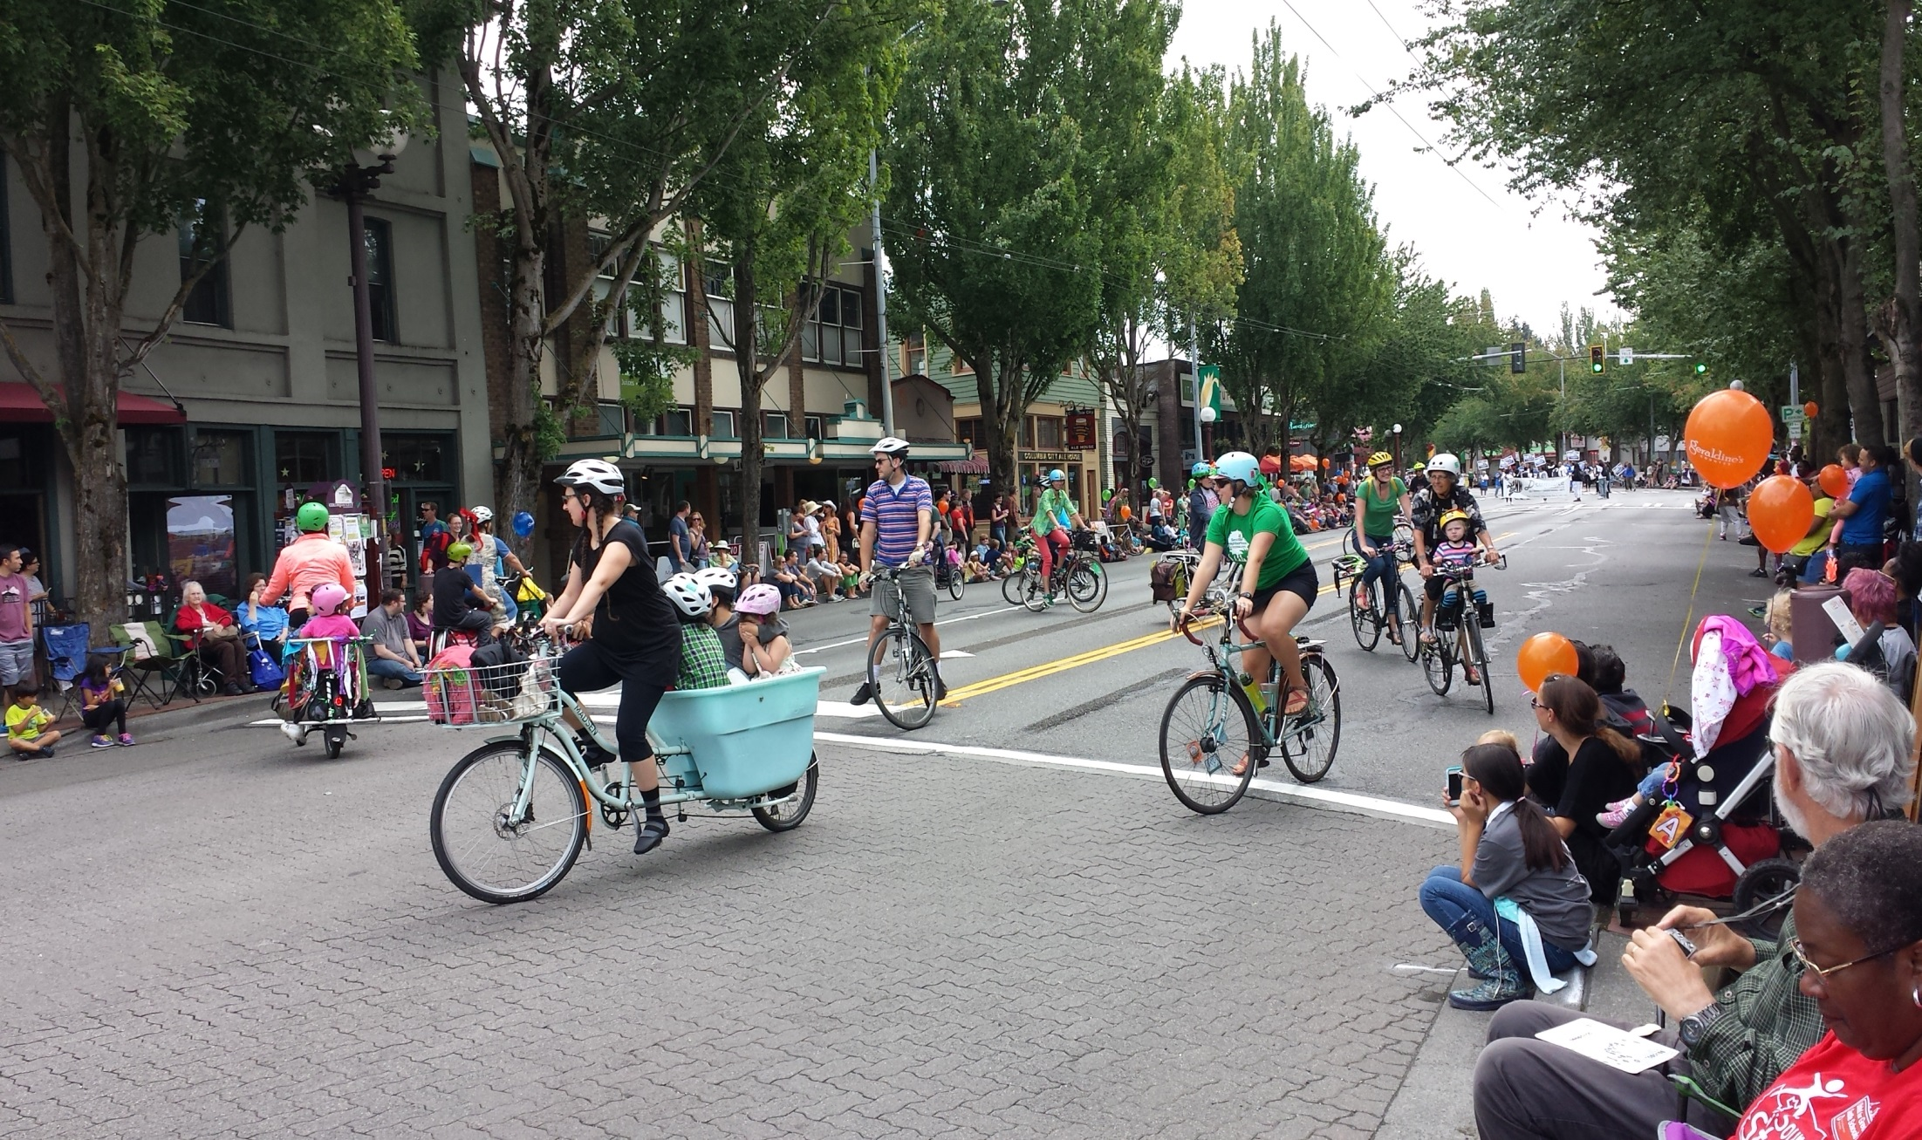

Rainier Avenue South
Pilot Project Update
Seattle Bicycle Advisory Board
Project Manager Jim Curtin
September 2, 2015

Slide 2
Our mission, vision, and core values
Mission: deliver a high-quality
transportation system for Seattle
Vision: connected people, places, and products
Committed to 5 core values to create a city that is:
Safe
Interconnected
Affordable
Vibrant
Innovative
For all
2
Notes:
Our core values for transportation anchor to the core values that Mayor Murray has laid out in his vision (Move Seattle) for Seattle:
Safe
Interconnected
Affordable
Vibrant
Innovative

Slide 3
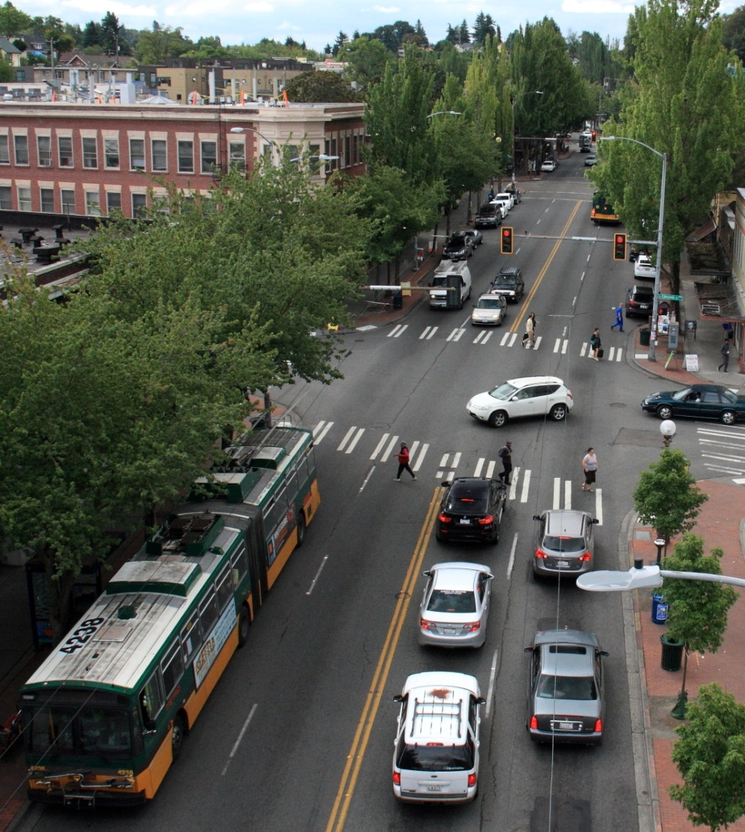
Presentation overview
Background
Existing conditions
Pilot project implementation
Next steps
3
Notes:
Let the audience know the purpose of your presentation (is it purely informational, are you seeking feedback, etc). Then walk them through what you’ll be covering.

Slide 4
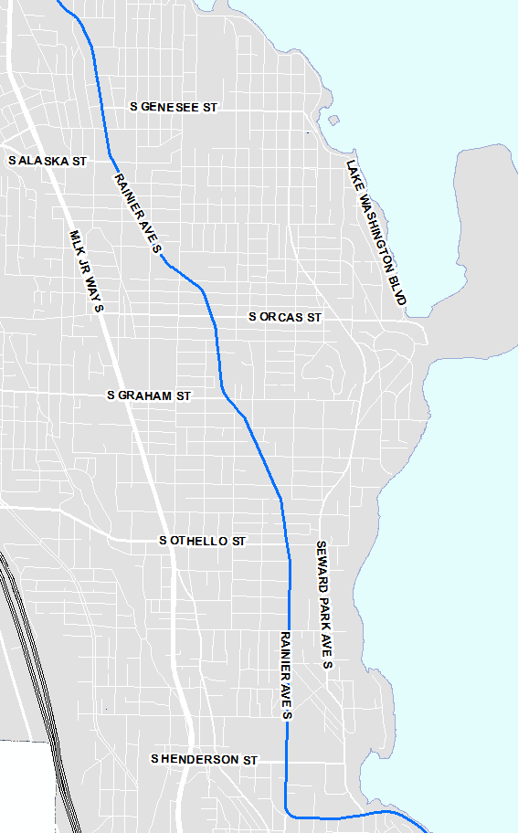
Background
Rainier Avenue S, between
Letitia Avenue S and
Seward Park Avenue S
November 2014: Corridor study began
March 2015: Design alternatives meetings
July 2015: Announcement of pilot project

Slide 5
Speed studies
Posted speed limit on Rainier was 30 miles per hour (mph)
Location | 85th percentile speed | Average number of high-end speeders (10+ mph over posted speed limit)
S Hudson Street | 35 mph | 611/weekday
42nd Avenue S | 38 mph | 1812/weekday
S Holly Street | 37 mph | 1083/weekday
S Cloverdale Street | 36 mph | 1083/weekday
5
Notes:
Text on left, image on right

Slide 6
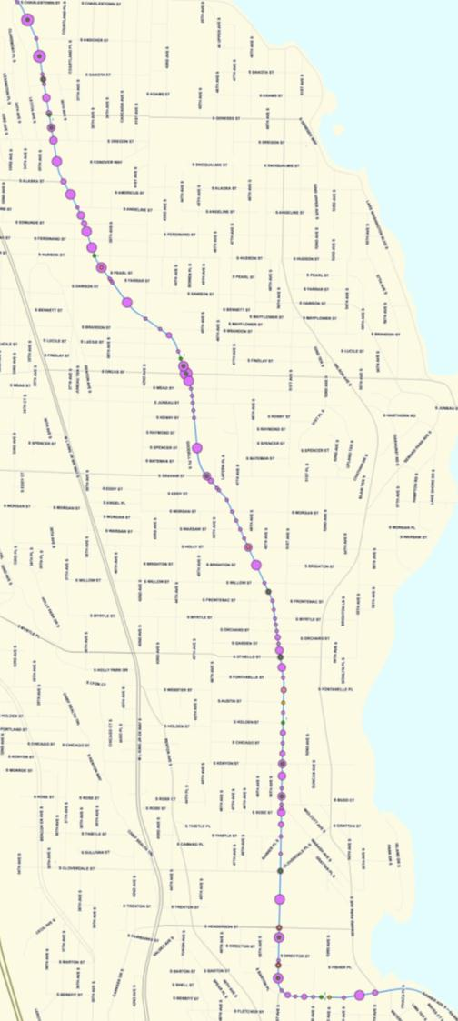
Collision data
Average of 1 crash/day on Rainier
Last 3 years
1243 total collisions
630 injuries
2 fatalities
Last 10 years
Nearly 3600 total collisions
1700+ injuries
11 fatalities
6
6
Notes:
Text on left, image on right

Slide 7
Collision data
Average daily traffic
37,000 to 74,400
34,600 to 40,400
19,700 to 26,600
7
Notes:
Text on left, image on right

Slide 8
Collision data
Average time to clear incidents = 47 minutes
8

Slide 9
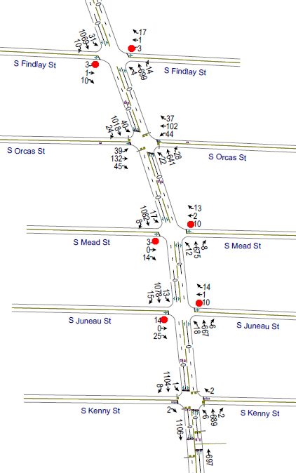
Data collection
Updated volumes on Rainier and nearby arterials
Turning movement counts collected at every intersection
  During AM peak, off-peak, and PM peak hours
  Includes counts of people walking, biking, using transit, and moving goods
Recorded corridor travel times
Reviewed detailed transit data
9

Slide 10
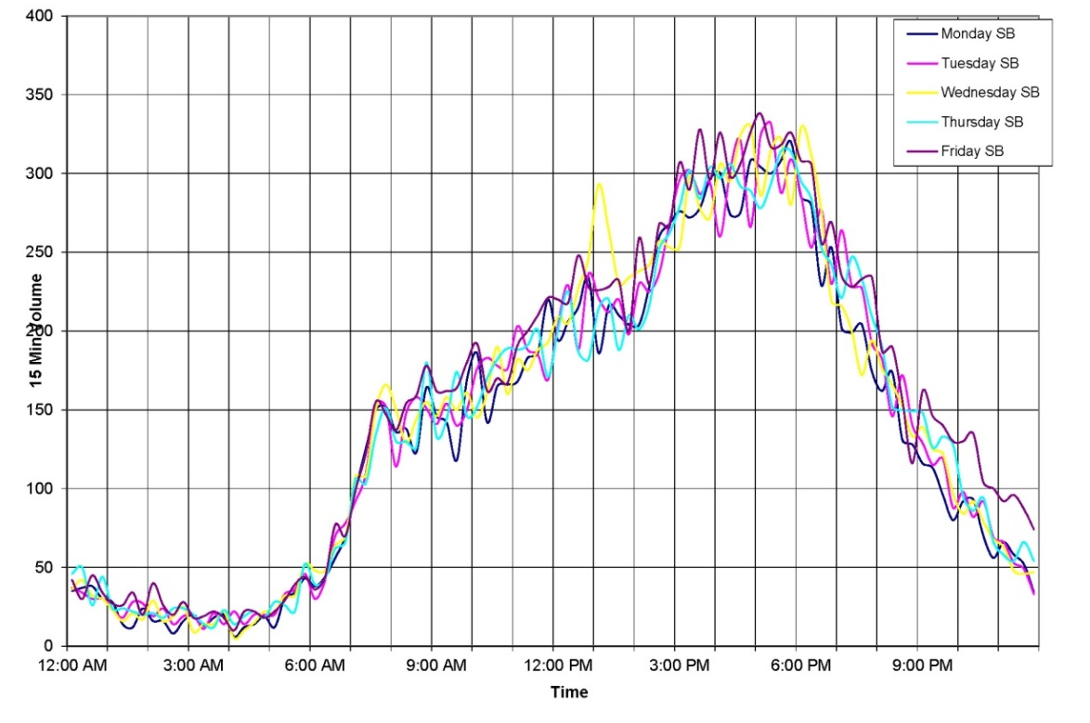
Traffic modeling
Peak period
Modeled “peak” period –hour of the day where recorded traffic volumes were highest
10

Slide 11
2015 pilot project
Rainier Avenue S, between
Letitia Avenue S and
Seward Park Avenue S
Rainier Avenue S, between
S Alaska Street and
S Kenny Street
July 30: Pilot project announced
August 3: Implementation began
August 6: Channelization and signal timing changes complete
August 14: Project substantially complete

Slide 12
2015 pilot project
Rainier “Pilot” Redesign
  Option 2 – hybrid design
  S Alaska to S Kenny (0.9 miles)
  One lane in each direction with center turn lane
  25 mph speed limit
  Longer pedestrian crossing time at all signals
  Leading Pedestrian Interval at Rainier and Ferdinand
  New parking spaces and more space to park on Rainier
TYPICAL CROSS SECTION (EXISTING)
7’
TYPICAL CROSS SECTION (PLANNED)
12

Slide 13
2015 implementation plan
Bus and turn lanes between Edmunds and Alaska
Southbound transit queue jump at Edmunds
Southbound left turns to be restricted at Edmunds
Left turns will be permitted at Angeline and PCC entrance
Turn restrictions at Safeway
TYPICAL CROSS SECTION (EXISTING)
CROSS SECTION (PLANNED)
Rainier at S Edmunds Street
13

Slide 14
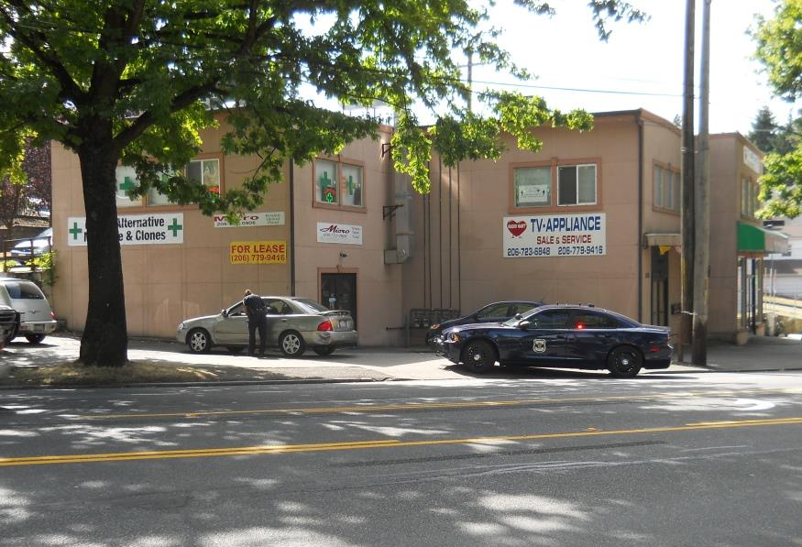
Enforcement
Increased enforcement efforts through SeaStat-Vision Zero partnership
Enforcement priorities:
  25 mph speed limit
  Left turn restriction at Edmunds
  Aggressive driving
14

Slide 15
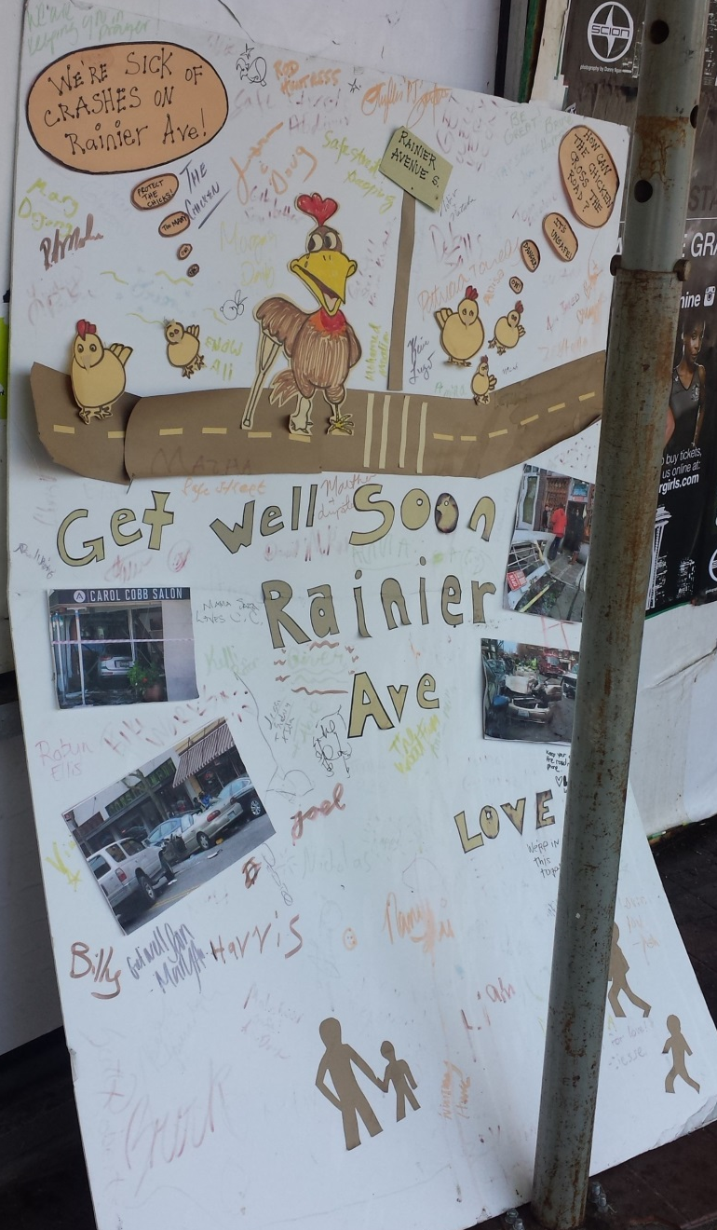
Evaluation
Evaluation began upon project completion
  Weekly travel time data collected for vehicles and transit
  Weekly speed studies
  Volume and turning movement counts on Rainier and nearby streets
  Monitoring collision data
  Signal, signage and channelization adjustments
  Public feedback
15

Slide 16
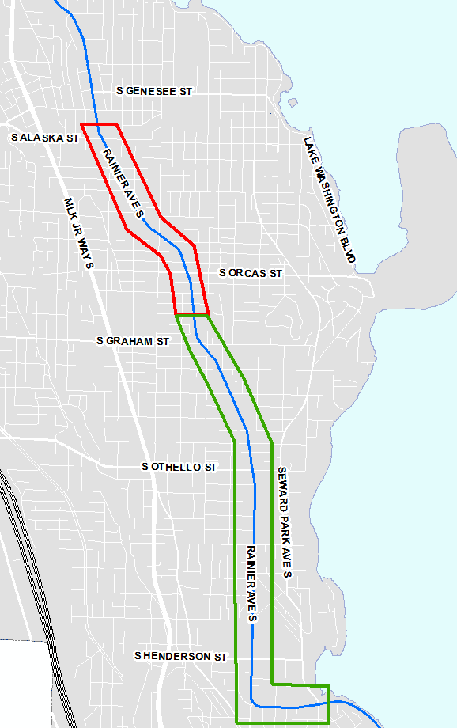
2015 - 2016
Continue analysis of design alternatives
Community design meetings
Engineering changes from south to north
Coordination with Greenway implementation and Accessible Mt. Baker project
Pedestrian signal design changes at Rainier and Oregon
2015
2016

Slide 17
Next steps
2015 | Evaluation and Vissim modeling
Winter 2016 | Project information sessions
Summer/Fall 2016 | Phase 2 implementation begins
17

Slide 18





Questions?
jim.curtin@seattle.gov | (206) 684-8874
www.seattle.gov/transportation/rainieraves.htm
www.seattle.gov/transportation

